Slide 1
The State of Western North American Monarch Butterflies
By Rahwa Woldeyesus, Katherine Dudzinsky, and Karen Warburton
Notes:
Thank you, Erik/Andrew...
Rahwa, Katherine, and myself worked on a project about the state of the Western North American Monarch Butterflies.

Slide 2

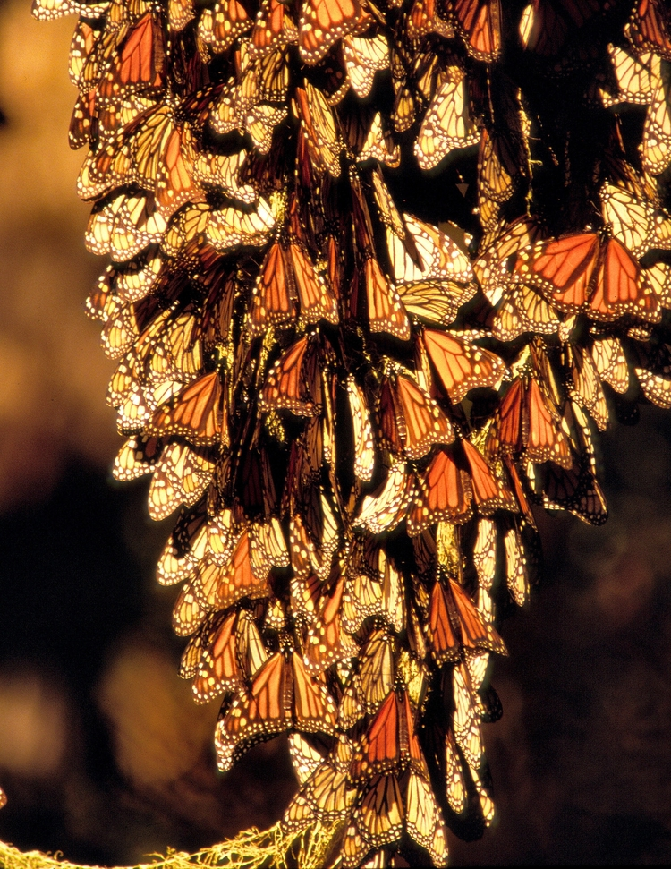
WESTERN MONARCH BUTTERFLY (Danaus plexipplus)
Introduction
Easy to recognize and commonly seen in California during active months.
Migrate long distances – 500 – 1600 km (about 300 – 1000 miles)! (Reppert, S.M. & de Roode, J.C., 2018)
Popular tourist attraction in some cities.
Important pollinators and consume weeds. (Korpella, R., 2021)
Recent studies indicate they are nearly gone. (Fimrite, P., 2020)
Image Credit: Pacific Grove Natural History Museum
Notes:
Western Monarch Butterflies, also known as Danaus plexippus --(pronounced “dan-EY-uhs PLEX-ip-pus”)– have captured the interest of people because it is easily recognizable, and here in California, they are typically abundant during late winter and spring.
Additionally, they have been of interest to scientists because of their migratory behavior. Every year, six species of Monarch Butterflies migrate from Northern sections of the United States, all the way to Mexico, and back again. In California, Monarchs are a popular attraction, mostly along the coasts as they travel from 500 to 1600 km or approximately 300 to 1000 miles to Baja California and return.
They have been seen in large numbers, completely covering trees along the coast, responsible for humans making sometimes annual treks to places like Monterey, San Luis Obispo, and San Diego.
Monarchs are important pollinators for trees and wildflowers, providing food to other animals (including humans), and are hearty weed eaters themselves.
But, according to scientists, the world’s most popular butterfly is on the verge of a fatal population decline.

Slide 3
WHY ARE D. plexippus DISAPPEARING?
Hypothesis
Scientists have expressed concern that this catastrophic reduction in Monarchs may be directly connected to climate change (Conservation of Migratory Species of Wild Animals, 2020)
Our hypothesis was that climate change is an influencing factor on the decline of the D. plexippus population.
Notes:
The loss of so many butterflies is concerning, and we thought it might be an interesting question to ask – why?
A search through the literature revealed that this is a hot topic in the scientific community right now.
We found many articles, such as the one cited here, that suggested climate change may be having the biggest contributing factor on the D. plexippus population.
Therefore, we decided to investigate climate change as an influencing factor on the D. plexippus population decline.

Slide 4
DATA SOURCES
Data
Terrestrial Air Temperatures from NOAA website (NOAA, 2021)
Butterfly Count Data from Xerces Society for Invertebrate Conservation (Xerces Society, 2021)
Notes:
We downloaded terrestrial air temperatures from select counties in California from the NOAA website for the known migratory months of November through March from the years 2000 to 2020.
We were able to locate counts for D. plexipuss. from the Xerces Society for Invertebrate Conservation. These counts occur annually in all the various counties by volunteers every year. We used twenty years of data from 2000-2020 and matched that to the NOAA temperature data.

Slide 5
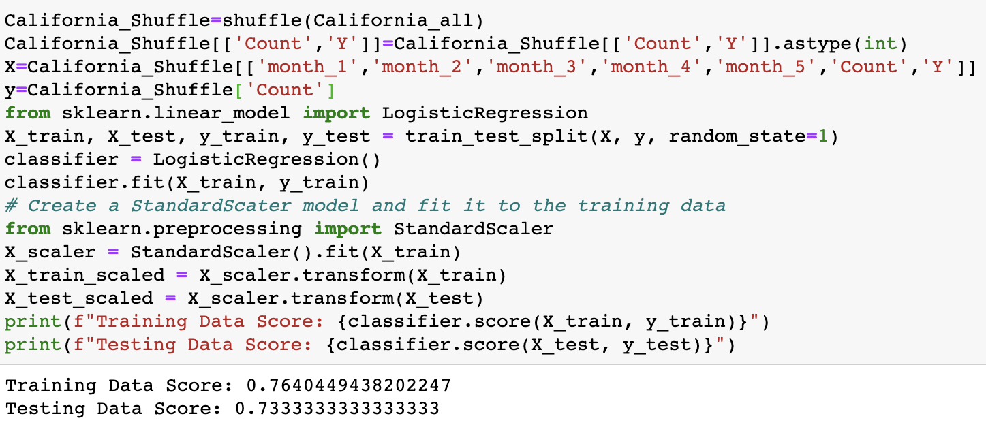
MACHINE LEARNING MODEL
Modeling
Considerations of TensorFlow Prediction of Temperatures
Linear Regression Model
Training Results
0.76
Testing Results
0.73
Notes:
At first, we wanted to build a machine learning model that could predict weather from our weather data past 2020, however, using the TensorFlow estimator proved to be a complex process, and since we were only working with a few months per year, it wasn’t going to be a great predictor for us.
We moved on to a linear regression model to determine if we could build a model that could predict whether butterflies should be present based on a given month of the year, temperature for anywhere in the state based on averages.
Our results from this model showed that our model training on average would result in a 76% chance to be successful, and our testing on average was 73% chance of being correct.
These results were good enough for potential predictions based on the variables indicated.
To obtain better results, we might have used temperature data from all months of the year if time had allowed.

Slide 6
MACHINE LEARNING MODEL
Challenges
Time for obtaining the appropriate data for a predictive model related to our hypothesis was an issue.
Linear regression model predicted information that did not relate to our hypothesis.
More time gathering data that would align better with the predictive model we would have provided the preferred predictions would have helped us be more successful.
Notes:
The main challenge for using Machine Learning at all in our project was that we did not have the time or information available to use the TensorFlow model that would have provided the predictions we were looking for – the potential for increased weather and what that might mean for D. plexippus.
The biggest challenge for us to overcome was presented when we realized that we did not have enough data in the right format in order to use any model for any purpose.
In the end, we used a model that would allow another person to come along and use our linear regression code to make a ”guess” if a combination of temperature, time of year, and geographic location would provide a realistic count. Unfortunately, this type of modeling did not reflect what our hypothesis was about at all.
If we had it to do over again, we would have been able to spend more time aligning locations between counts and temperatures and use a different model to show predictions of what the fate of D. plexippus might be should terrestrial temperatures rise.

Slide 7
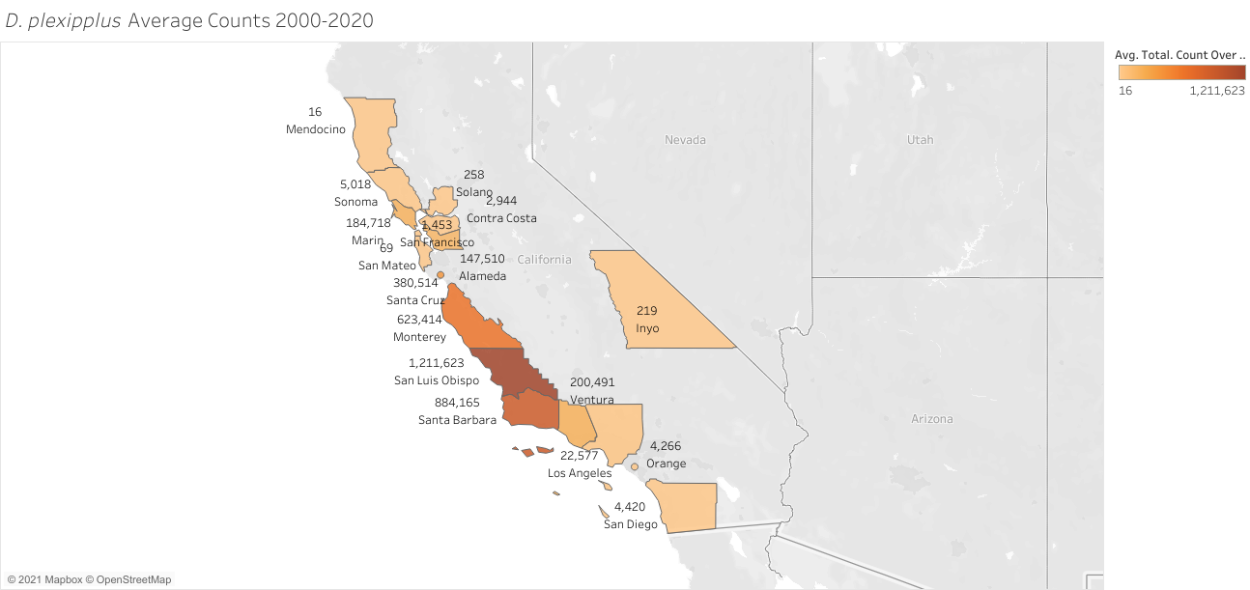
WHAT WE DID FIND
Findings
Notes:
Using Tableau, we were able to create a map that shows the average counts of D. plexippus by county for all 20 years.
As is shown in this map, most of the counties are located nearby the coastal cities, with the highest averages in the central California region.

Slide 8
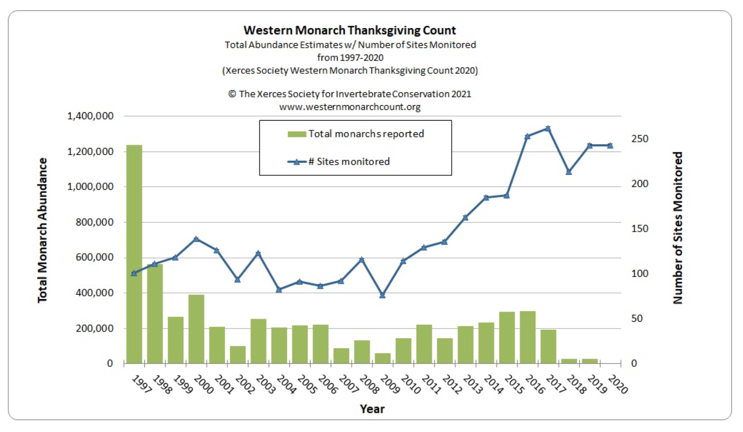
WHAT WE DID FIND
Findings
Notes:
While we were researching the D. plexippus counts, the Xerces Society for Invertebrate Conservation provided this interesting graph, indicating that over the past 23 years, as the number of sites monitored increased, shown by the blue line, the counts of the butterfly, indicated by the green bars, actually declined. Alarmingly so, in the past few years.

Slide 9
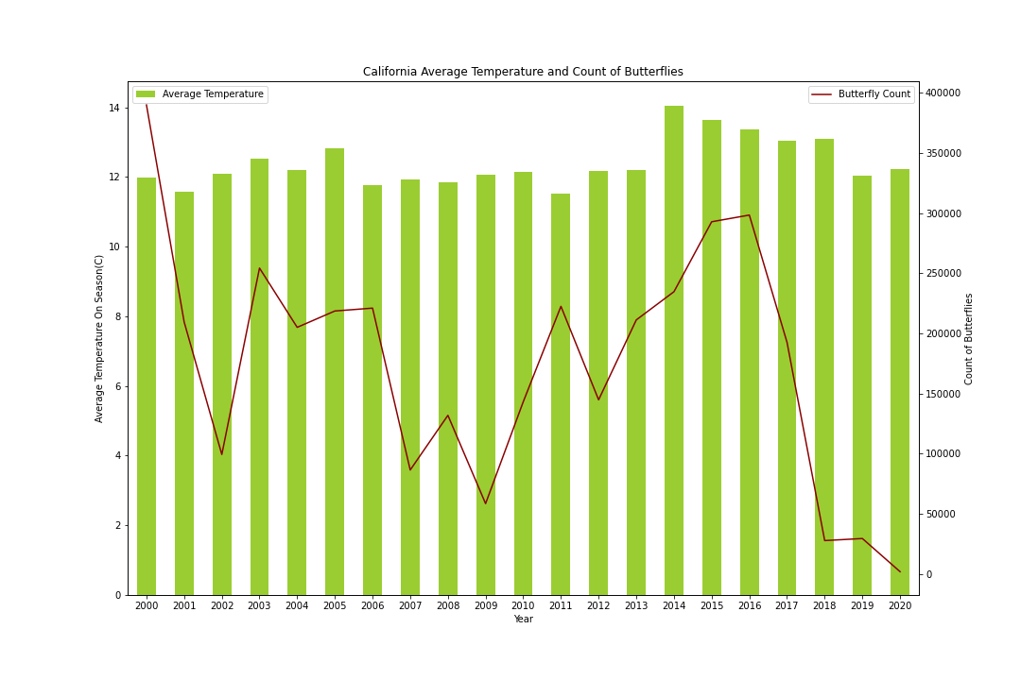
WHAT WE DID FIND
Findings
Notes:
Using Python, Pandas, and Matplotlib, we created a graph showing the Total Count per Year vs. the Average Temperature per season.
This graph provides a visualization showing that while temperatures may be going up and down, starting in about 2016, butterfly populations plummeted.
We thought it would be interesting to look at the various areas of the state in three segments: Northern, Central, and Southern, because of the differences in temperature, and see if there we could determine a trend in temperature.

Slide 10
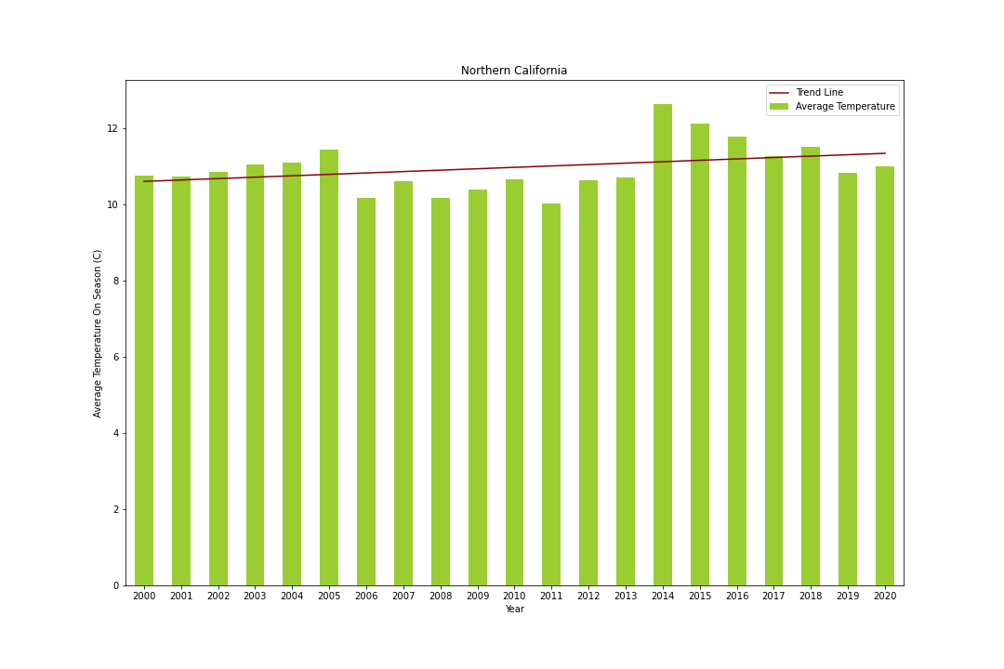
WHAT WE DID FIND
Findings
Notes:
Using Python and Pandas, we created additional graphs for various sections of California that show the average temperature in the region during the on-season, and a trend line.
This graph provides a visualization of Northern California. This includes all counties along the coast from Mendocino, past San Francisco and through San Mateo.
Here we see a trend line increase of about 0.5 degrees Celsius, or 32.9 degrees Fahrenheit over the 20 year time span.

Slide 11
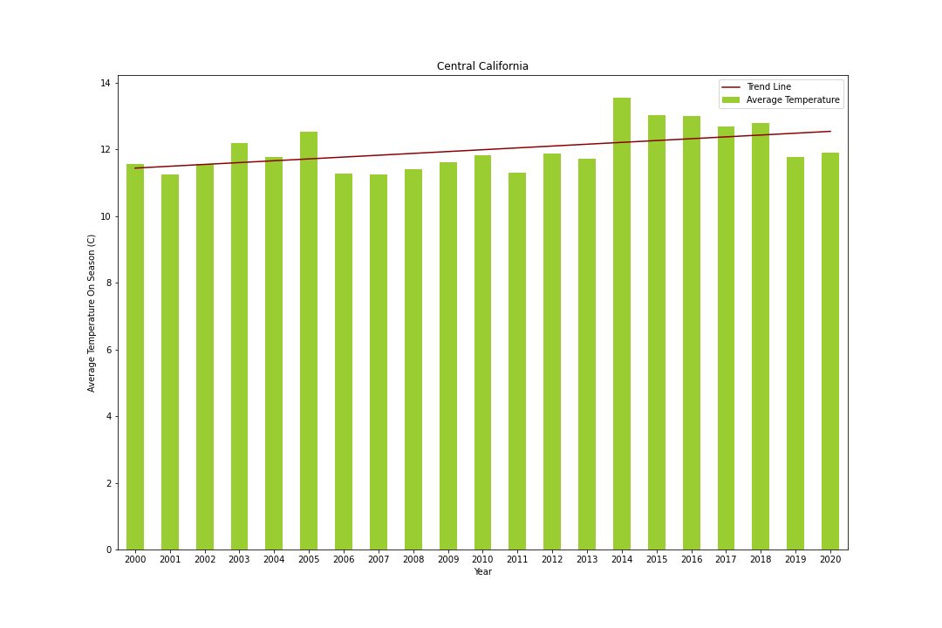
WHAT WE DID FIND
Findings
Notes:
The next region of Central California coastal counties includes a graph of the counties from Santa Cruz through San Luis Obispo.
Here we see a trend line increase, again, showing a similar increase in temperature of our Northern California region over 20 years.

Slide 12
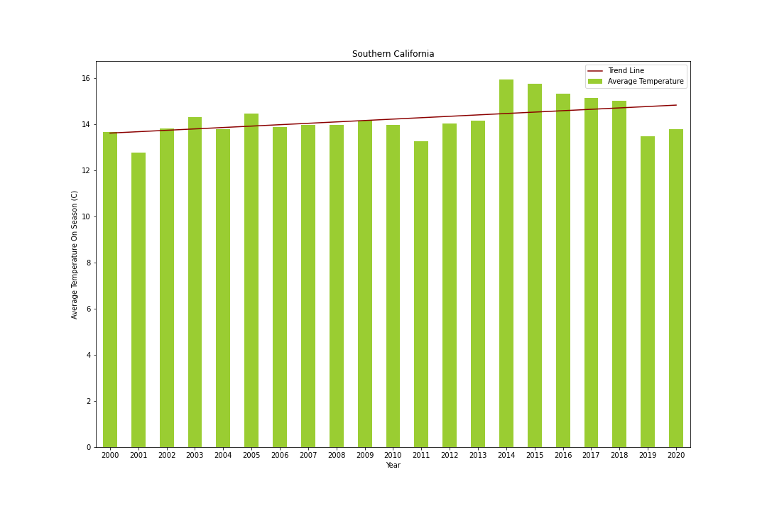
WHAT WE DID FIND
Findings
Notes:
The third and final region of Southern California counties includes a graph of the counties from Santa Barbara, south, including Inyo County.
Again, although temperatures naturally increase as we move South, we are seeing the exact same trend here.

Slide 13
WHAT ABOUT OUR HYPOTHESIS?
Variables
Is climate change responsible?
Is there something else influencing the problem?
Let’s learn about entire life cycle of D. plexipplus.
Notes:
So, getting back to our original hypothesis – that is, that we would see a decline in the D. plexippus population with increased terrestrial temperatures.
What can we conclude from our research, coding, and results?
It is very difficult to determine from the data and analyses conducted in this project that climate change alone is the sole contributor to population decline.
However, there are plenty of hypotheses about the concerning decline of this species in the scientific community.
To really understand the reasons, we must understand the entire story of the life cycle of this invertebrate.

Slide 14
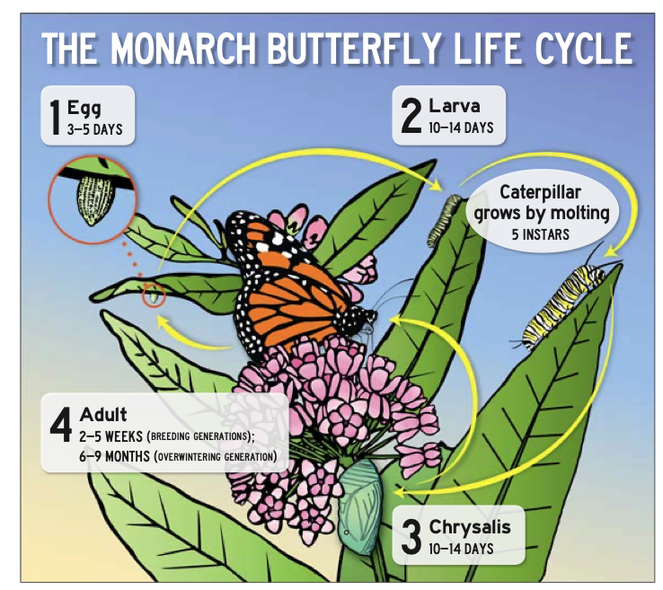
D. Plexippus Life Cycle
Variables
Image Credit: Monarch Joint Venture, 2021
Notes:
The D. plexippus butterfly starts its life as an egg, which hatches within a few days. After the eggs hatch, it grows during a larval stage and into a caterpillar for approximately a month. During this time period, it feeds off one type of plant, known as a Milkweed.
After growing enough, the caterpillar builds its chrysalis (pronounced KRIS-uh-lis).
And approximately 2 weeks later, a beautiful adult butterfly is metamorphized, and begins its journey southward for overwintering. During this time, they are pollinating, and feeding. After 6-9 months, the butterflies begin to move north again, when they breed, lay eggs in a Milkweed plant, and die.

Slide 15
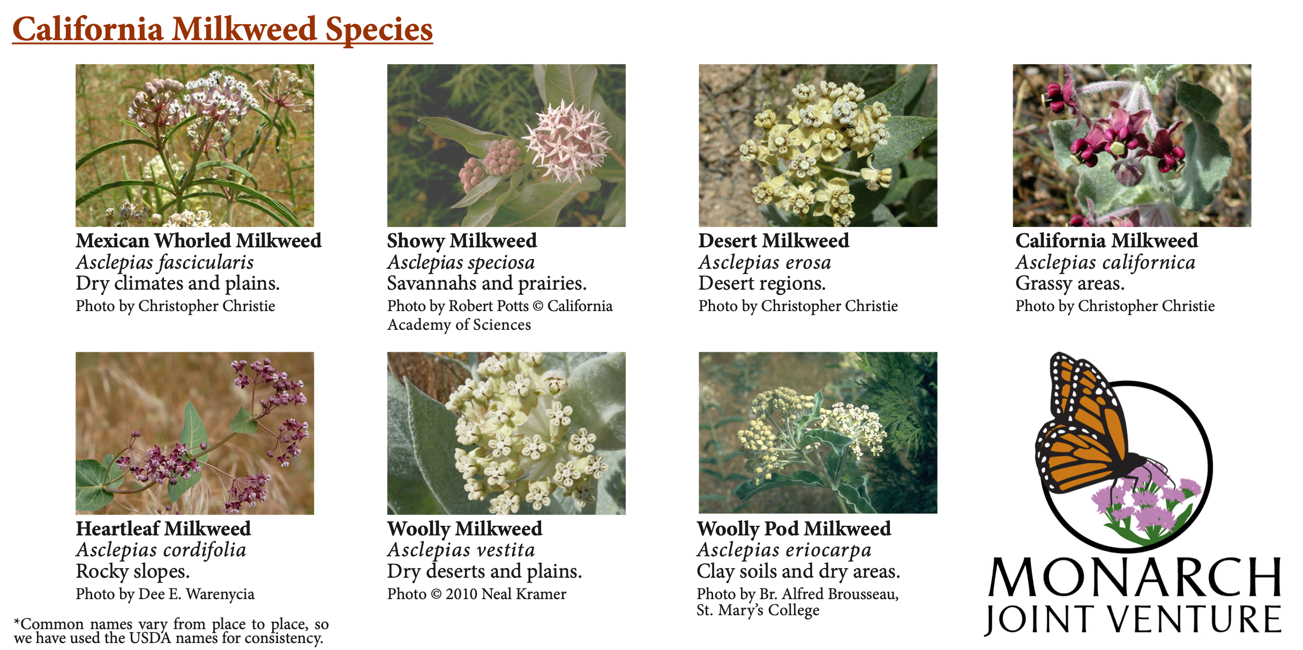
Milkweed (Asclepias sp.)
Variables
Image Credit: Monarch Joint Venture, 2021
Notes:
There are many different species of Milkweed, but all share the same Genera, Asclepias (pronounced ask-PLES-peeus) that D. plexippus lays its eggs in.
Only seven different species grown in California.
Is it possible that increases in temperature could be affecting the growth of the weed that the larva and caterpillars rely on for sustenance?

Slide 16
Pesticides, Herbicides, Human Interaction
Variables
Are pesticides responsible?
Are herbicides responsible?
Is human interaction responsible?
Notes:
What about other types of variables?
Is it possible that pesticides are killing off D. plexippus?
Is it possible that herbicides are killing off the Milkweed?
What about human interaction? When we see what we think is a “weed”, are humans removing a plant that is critical for the survival of the Monarch Butterfly?

Slide 17
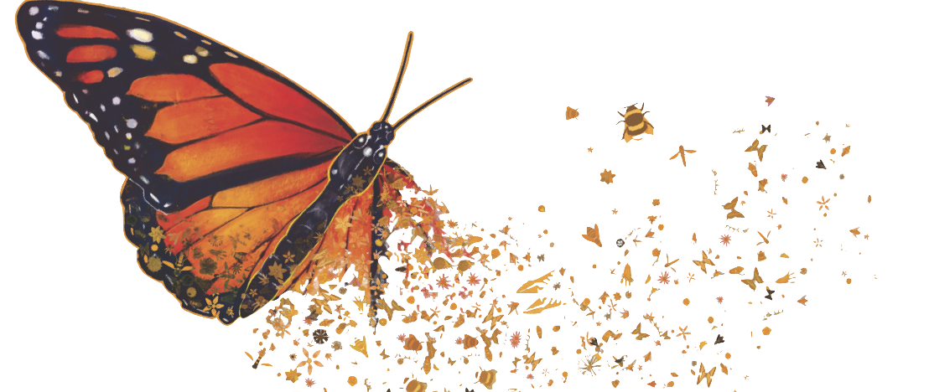
Conclusion
Notes:
The truth is, the influencer on the potential loss of this species could be any of things, or a combination of these things.
Therefore, at this time, advocates are urging people to refrain as much as possible from using pesticides and herbicides.
There is also a big effort to plant Milkweed, and to become actively involved in counting Monarchs.
And we can’t forget that we all should be putting forth an effort to minimize the effects of climate change.
By paying attention to the potential suspects until we fully understand the problem, we may just have a chance to save this beloved butterfly before she completely disappears.

Slide 18
References and Data Sources
References
Fimrite, Peter, "Slim hope for monarch butterflies: Population holds steady this season” San Francisco Chronicle, 23 September 2020
Korpella, Robert. "What do Butterflies do for the Environment?" sciencing.com, https://sciencing.com/what-do-butterflies-do-environment-4580181.html. 20 March 2021.
Monarch Joint Venture, University of Minnesota, “Fact Sheet About Milkweed” http://monarchjointventure.org/images/uploads/documents/MilkweedFactSheetFINAL.pdf. 20 March 2021.
National Centers for Environmental Information, National Oceanic and Atmospheric Administration. “Climate Data Online Search”, https://www.ncdc.noaa.gov/cdo-web/search. 20 March 2021.
Pacific Grove Natural History Museum. “Monarch Viewing”, https://www.pgmuseum.org/monarch-viewing. 28 March 2021.
Reppert, Steven M. and de Roode, Jacobus C. “Demystifying Monarch Butterfly Migration” Current Biology 28, R1009-1022, 10 September 2018
Xerces Society Western Monarch Thanksgiving Count. 2021. Western Monarch Thanksgiving Count Data, 1997-2020. Available at www.westernmonarchcount.org.
Notes:
Here are the references and data sources we used in our project.

Slide 19
Questions
Questions?
Notes:
Now, we would like to open up some time for questions.

